Slide 1
ENSE 471, Milestone 3
Prime Software
MJ, SANA, MCKENZIE, JIAHAO
April 10, 2019

Slide 2
Balsamiq Prototype
https://balsamiq-wireframes.appspot.com/?state={%22action%22:%22open%22,%22ids%22:[%221sH-srl4PGGBY9HxXJfni7fmXtdRVOihD%22],%22userId%22:%22110091217072312009504%22}
Notes:
So in this final iteration of our prototype, we felt it was finally necessary to combine both future students and parents into one
So looking at our homepage, we had a huge focus on usability. Making sure to keep things simple and focused. Cause we wanted to hone in the attention of our users dead center on the page, cause it's essentially what they need and it takes away the distraction
Some of the things that helped make this desirable/understandable are our knowledge in the world turned knowledge in the head.
Because alot of us have been using websites alot, there are some things from this experience that has been picked by our subconscious.
Some of the affordances ported over from our website experiences are
1: the visual cues, letting you know what tab you're on
Q. How to apply to software engineering
Signifiers: arrows
connstraint : location f pattern
when building your Balsamiq prototype ensure to link software engineered experiences to concepts learned in class, i.e. how are you aiding conscious/sub-conscious interaction, how is your design “humane,” is discoverability and understandability represented, and how did your team integrate ideas of affordances, signifiers, natural mappings, metaphors, legacy, safety, design for error, and constraints? Remember, your team will have to discuss a minimum of three linkages accordingly in your final presentation.

Slide 3
User Feedback
The Users loved tile representation of data
Originally we our social media placement/news, moved it to a more central location.
Not having it as a main focus was an issue
The most important feedback received was the way we represent the target customers front and center.
Likes?
The dynamic design
Target customers are the main focus
Better ifs?
Filling the outside/whitespace with some sort of information

Slide 4
Cascade Server Integration
Limited to static website design
Pros: Does not require complex programming
Cons: Cannot implement advance features such as dynamic navigation bar

Slide 5
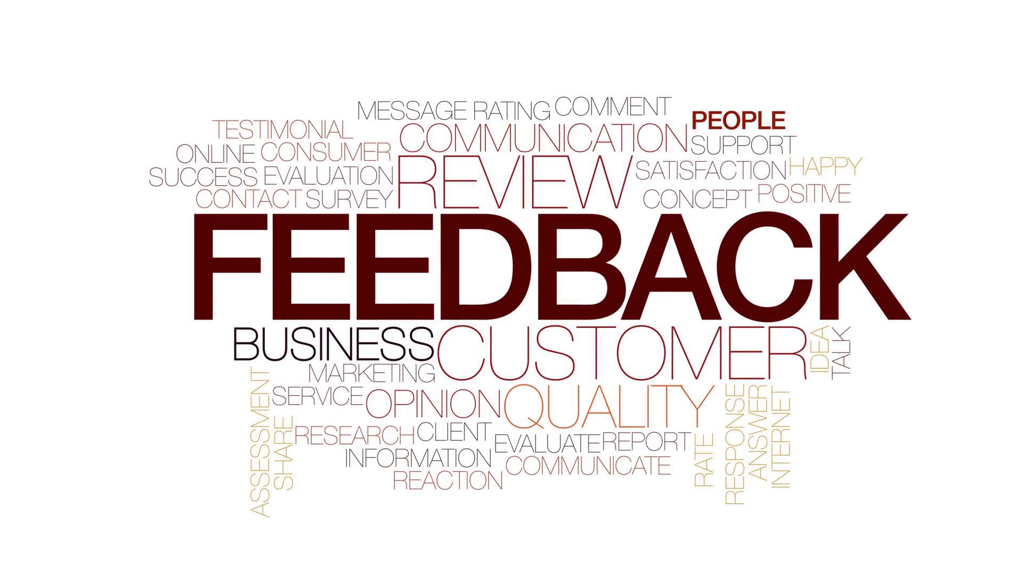
Comments & Next Steps
Relationship with Target Customers - “You != User”
Target customers’ needs and desires
Feedback & Reflection
Recall the fast feedback cycle
Provides a way to achieve goal of design
Future project - software engineers
Responses are Critical
Design a useful, usable, and desirable solution for the public Engineering website
Notes:
Jiahao Li
Relationship with stakeholders - understanding your stakeholders’ needs and desires based on what they have experienced is important
Based on what we received feedback from target customers through this whole process of the project, we noticed that it is definitely necessary to receive target customers feedback because target customer feedback provided a way to our team to achieve the goal of what they wants or what they really care about in this new public Engineering website design.
In the future, keep communicating with your target customers

Slide 6
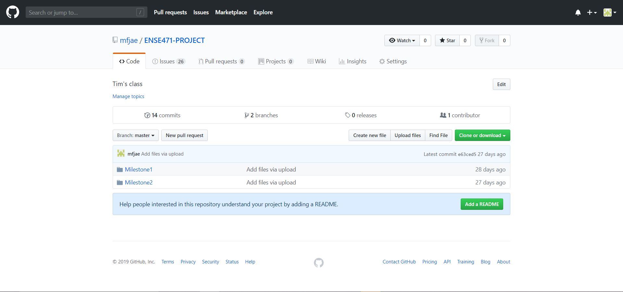
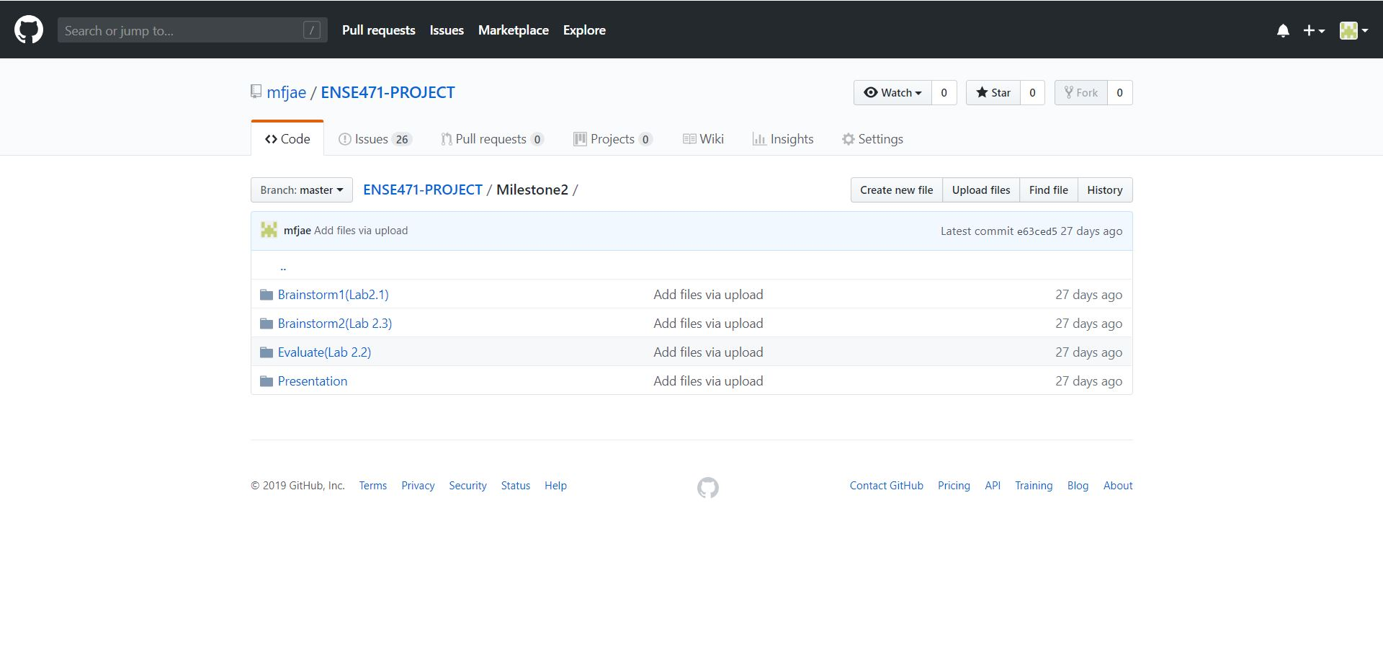
GitHub-Stamp of approval

Slide 7
Group Reflection
•How did you feel about this project? What did you like about it? What did you dislike?
One of the things that we really like is the interaction with target customer/ stakeholders which gave us better understanding of stakeholder perspective.
•What did you learn about yourself as you collaborated and worked through this project?
Throughout this project, we learned to collaborate, shared ideas and feedbacks.
•How will you use what you have learned on this project going forward?
Interaction with clients to have better understanding
Storyboards
Notes:
Sana

